Slide 1
NLP-AI
Java Lecture No. 9
@CoderBaba

Slide 2
Contents
Objects & Class (Revision)
Methods
String Class
@CoderBaba

Slide 3
Object & Class
Examples :
Class : Object :
Man Abdul Kalam
Fruit Banana
Language Java, Marathi
Car Maruti 800, Santro
Fort Lohgadh, Raigadh
Software Lab CFILT, TCS, CFDVS
Shooter Major Rajvardhan Singh Rathore
@CoderBaba

Slide 4

Object & Class ….
These objects have different colors, locations & sizes.
Do they belong to the same class?
@CoderBaba

Slide 5
Object & Class ….
Class denotes category of objects, and act as blueprint for creating such objects.
Object of same class have same structure, it exhibits properties & behaviors defined by its class.
Properties is also called as attributes/fields & behaviors as methods/operations.

Slide 6
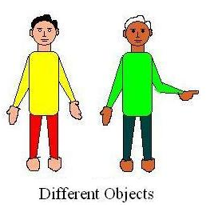
Class & Objects …
Class :
Attributes:
Hair, eyes, face, Neck,
torso, hands, legs.
Fingers, height, weight,
age.
Methods:
walk(), talk(), point(),
Laugh(), cry(), dance(),
steady()
[Definition of Class Man]
man.java
@CoderBaba

Slide 7
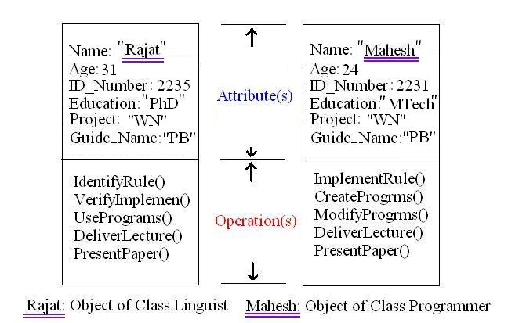
Object & Class …
@CoderBaba

Slide 8
Method
Need for Method
General Syntax
<return type><method name>(<parameter list>)
{ //method body
<statement(s)>
}
NOTE: Methods are always declared inside class.
Return type is void if not returning anything, else concern data-type.
Modify man.java
@CoderBaba

Slide 9
Method Examples
void hello(String guest){
//not returning anything
System.out.println(“Oh! Hello ” + guest);
}
int ReturnSquare (int a_number){
//returning data of type int
int square = a_number * a_number;
return square;
}
Refer : sayHello.java
@CoderBaba

Slide 10
String Class
String is a very special class in Java.
Strings are constants, their values cannot be changed after they are created. But they can be reinitialize.
String here=“I am here”;
here=“I am there”;//previous one is completely deleted
Our rules and dictionaries can be stored string class.
This class is armed with useful methods….
compareTo(String str), concate(String str), endsWith(String str),
indexOf(int ch), length(), startsWith(String str),
lastIndexOf(String str).
@CoderBaba

Slide 11
String Class…
String machine = “pentium”;
int comp = machine.compareTo(“pentium”); //comp=0;
String lab= “Language”;
lab=lab.concate(“ Technology”); //lab=“Language Technology”;
int ind = machine.indexOf(‘t’);
boolean start = machine.startsWith(“pen”); //true
boolean end = machine.endsWith(“um”); //true
String part1=machine.substring(0,3); //part1=“pen”;
String part2=machine.substring(5);//part2=“um”;
Refer str1.java, reg.java
@CoderBaba
@CoderBaba

Slide 12
Assignments
Mention your own class with some attributes & methods.(do not implement).
Enhance reg.java’s code to accept a string only of characters from A to Z. (all in Upper case.)
Example:
AHCD is accepted.
A3HCD is rejected.
43534 is rejected.
@CoderBaba

Slide 13
End
Thank You!
@CoderBaba

